Slide 1

Extended Project Qualification Linux: The OS You Control
Author: Akim Komarnitskii

Slide 2

Why Linux?

Slide 3
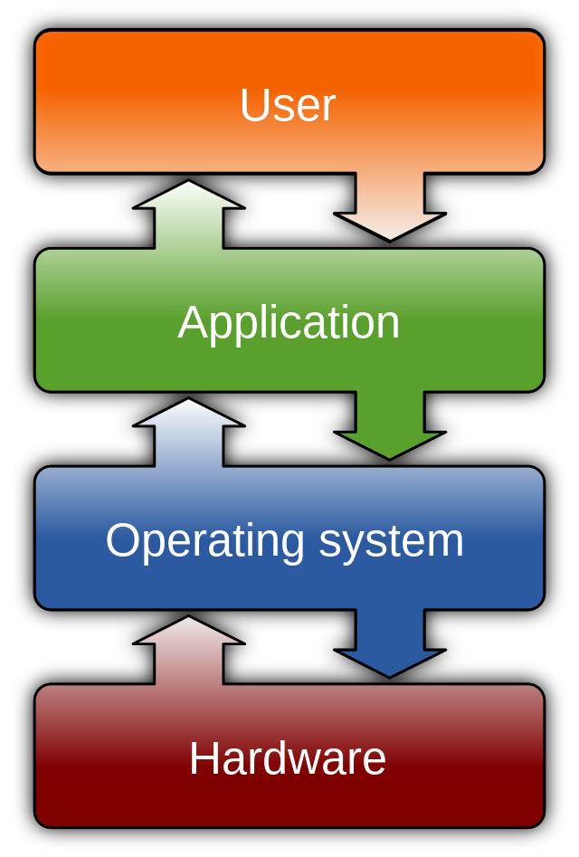
Operating Systems
An Operating System (OS) is an interface between a computer user and computer hardware. It is a software which performs all the basic tasks like file management, memory management, process management, handling input and output, and controlling peripheral devices such as disk drives and printers.

Slide 4
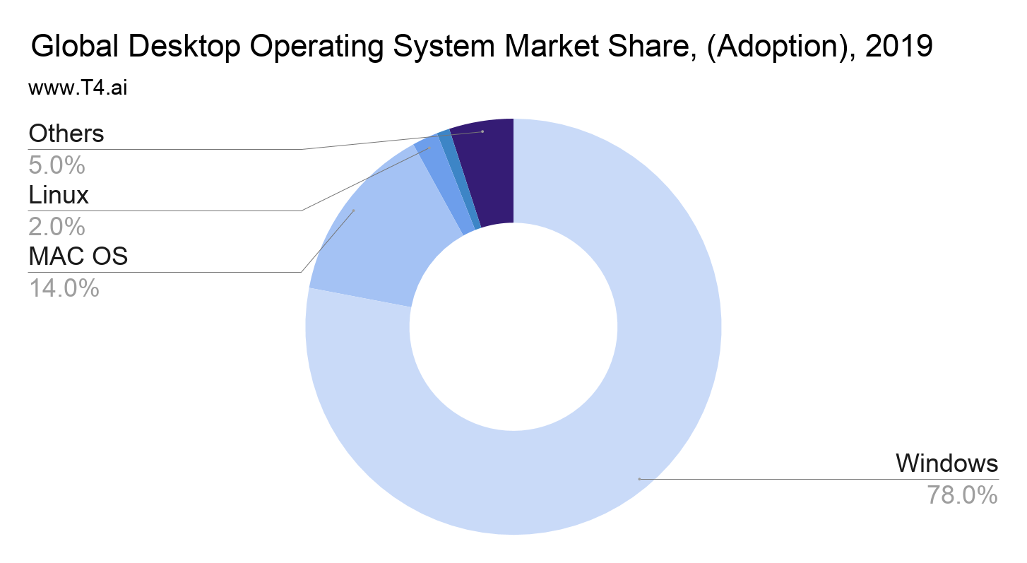

Slide 5

Windows
Leading OS with almost 1.5 billion users
Simple and intuitive GUI off-the-shelf
The price of Windows 10 Pro is $199.99
Closed source
Limited customizability
Data collection for advertisement purposes raises concerns

Slide 6

Mac OS
Second largest OS
More customizable
Partially open source (closed source API)
Only available on Apple devices
The minimum price of a MacBook is $999

Slide 7

Linux
Four essential freedoms:
1) The freedom to run the program as you wish, for any purpose (freedom 0)
2) The freedom to study how the program works, and change it so it does your computing as you wish (freedom 1). Access to the source code is a precondition for this.
3) The freedom to redistribute copies so you can help others (freedom 2).
4) The freedom to distribute copies of your modified versions to others (freedom 3). By doing this you can give the whole community a chance to benefit from your changes. Access to the source code is a precondition for this.

Slide 8

Linux
No privacy concerns
Can run on any device or hardware
Unlimited customizability
May be overwhelming
Software compatibility

Slide 9
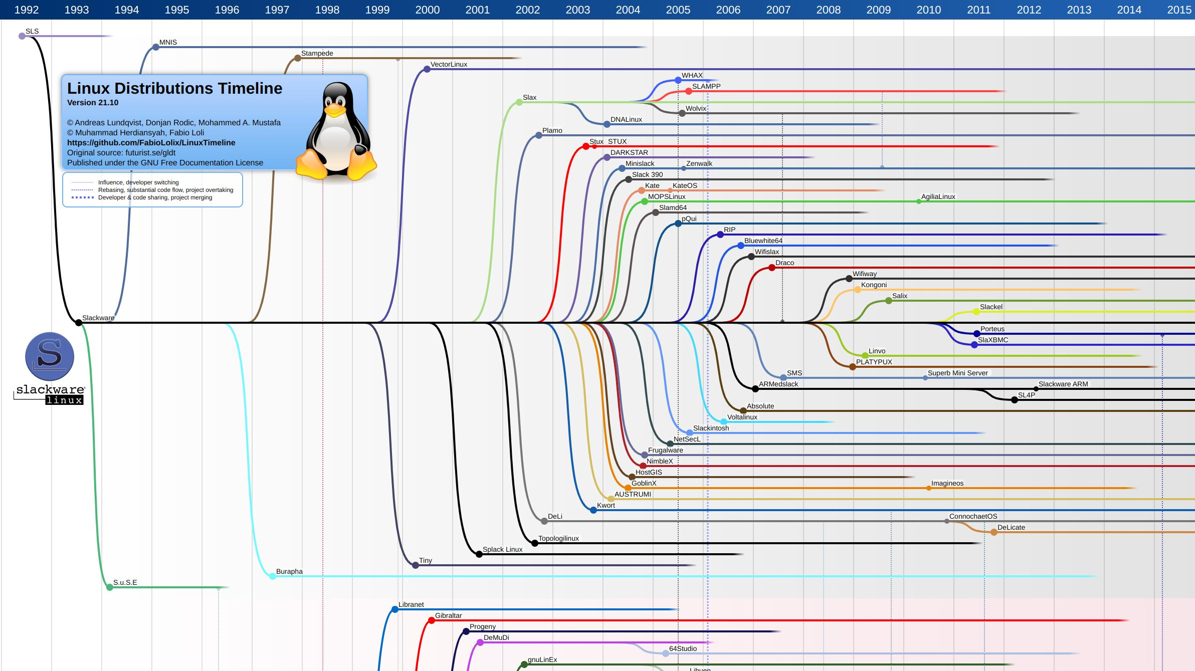
Which Linux?
A Linux distribution is an operating system made from a software collection that includes the Linux kernel and, often, a package management system.
Full image

Slide 10
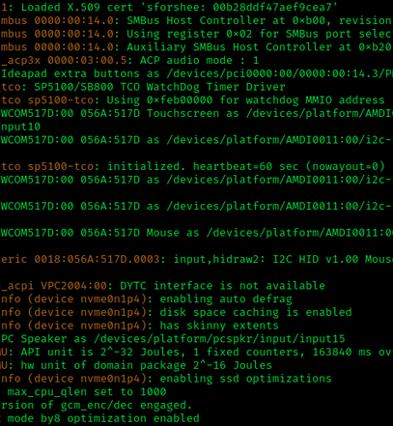
Everyday VS Specialised Use
Beginner friendly distribution with a DE for everyday use
Gaming: Fedora Games spin, Ubuntu GamePack (85000+ games)
Ethical hacking: Kali Linux, BackBox (Pre-installed tools)
Web server: Debian, Ubuntu server (LTS, focus on stability)
Any purpose: LFS

Slide 11
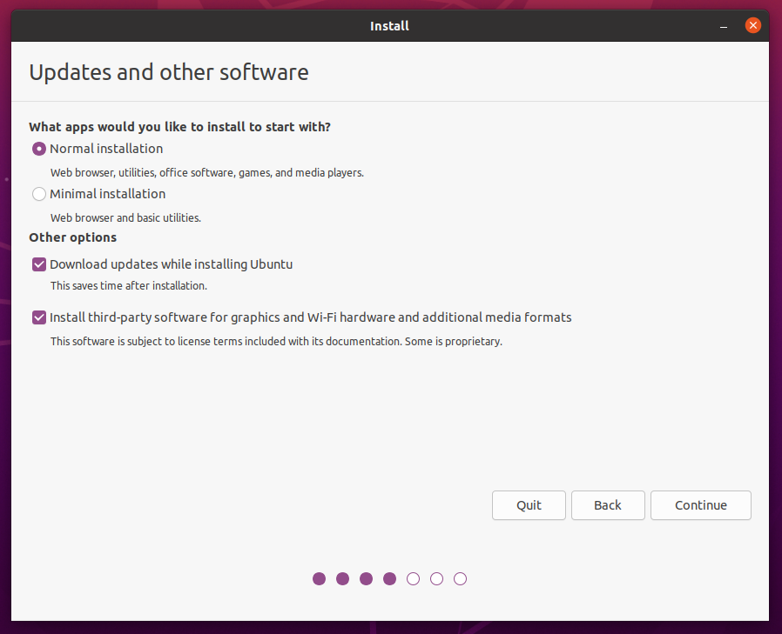
Beginner Friendly VS Advanced
The more beginner friendly a distribution is, the more similar it is to systems such as Mac OS and Windows.
Example: Ubuntu

Slide 12
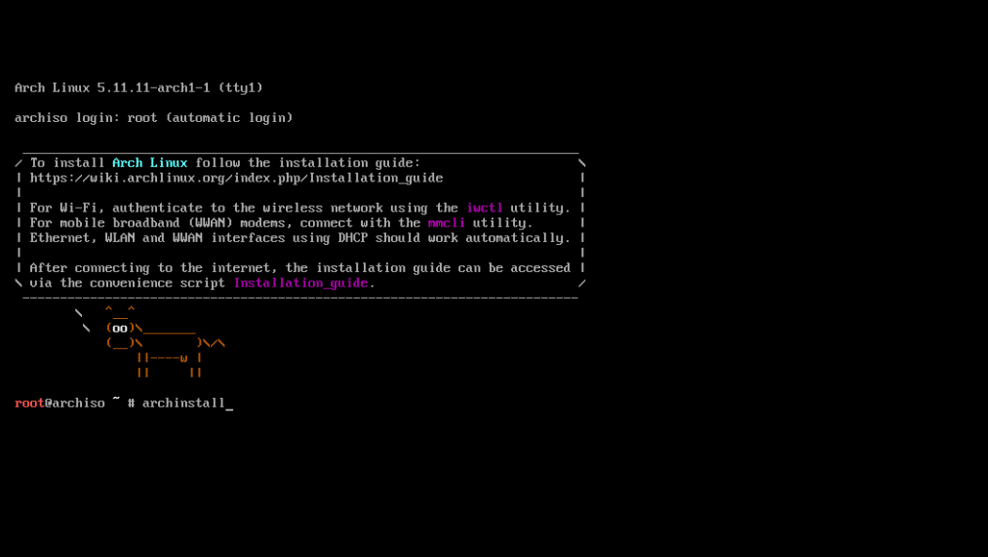
Advanced
The more advanced a distribution is, the more different it is intially from the mainstream OSs
Example: Arch Linux

Slide 13
 | Beginner Friendly | Intermediate | Advanced
1. | Ubuntu | Manjaro | LFS
2. | Linux Mint | Fedora | Arch Linux
3. | Pop!_OS | OpenSUSE | Slackware
4. | Elementary OS | EndeavourOS | Gentoo
5. | Debian | Garuda Linux | NixOS

Slide 14
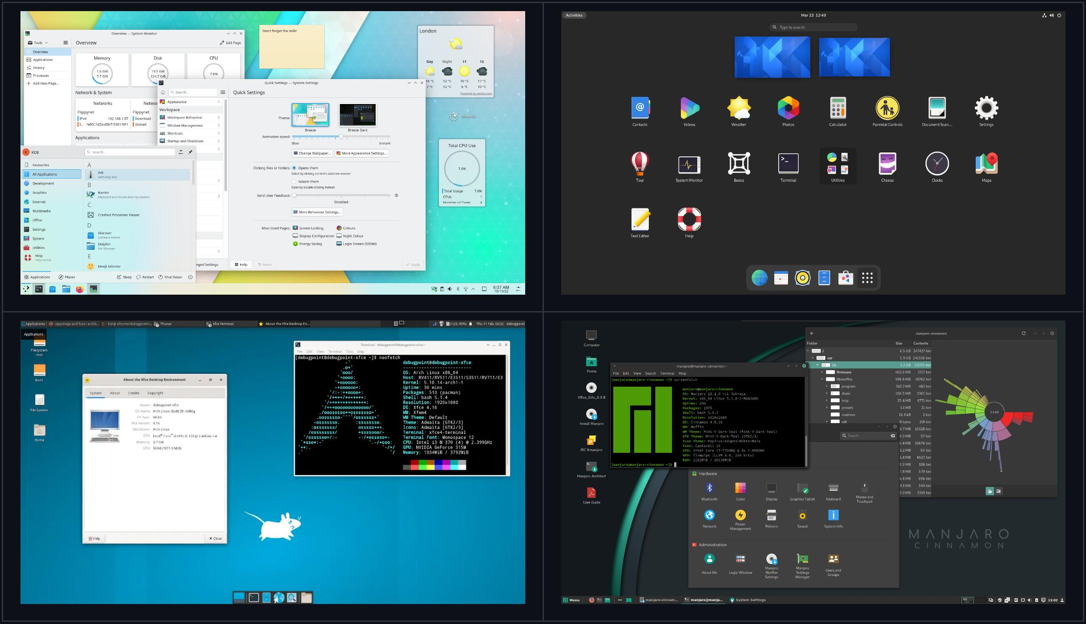
DE VS WM
A Desktop Environment (DE) is a collection of software running on top of an operating system that makes up the desktop Graphical User Interface. It usually includes everything from how the windows look and feel, to the style of the icons, files, folders, and the mouse pointers. A desktop environment also dictates what file manager to use, default text editor, image viewer, wallpapers, and the interface used to log in and log out of the local system.

Slide 15
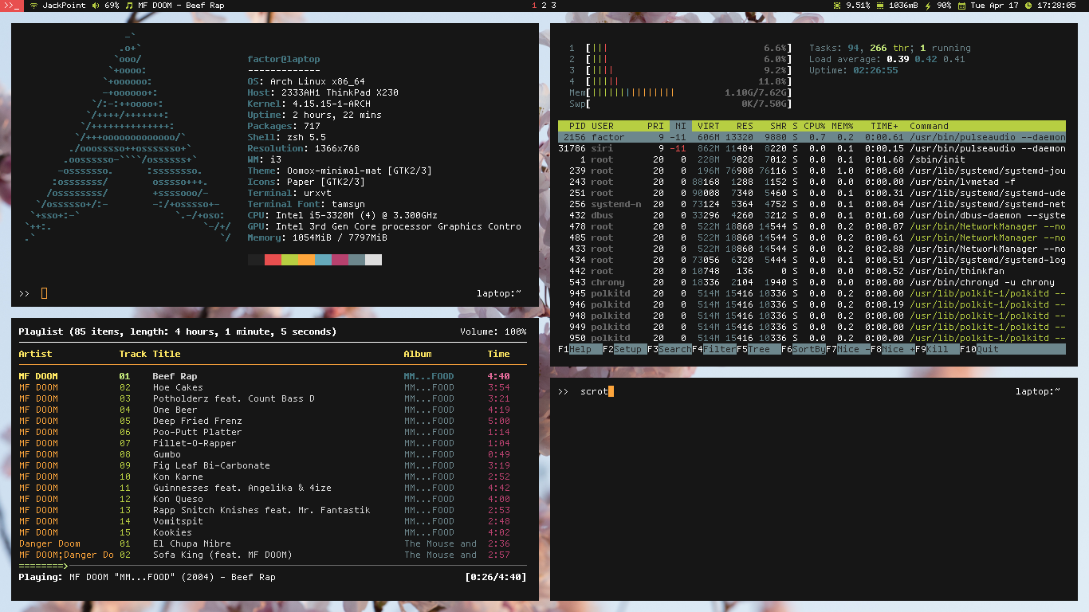
A Window Manager (WM) is a software utility hat manages the overall alignment and layout of graphical windows.
There are 3 main types of WMs:
1) Stacking (a.k.a floating)
2) Tiling
3) Dynamic

Slide 16
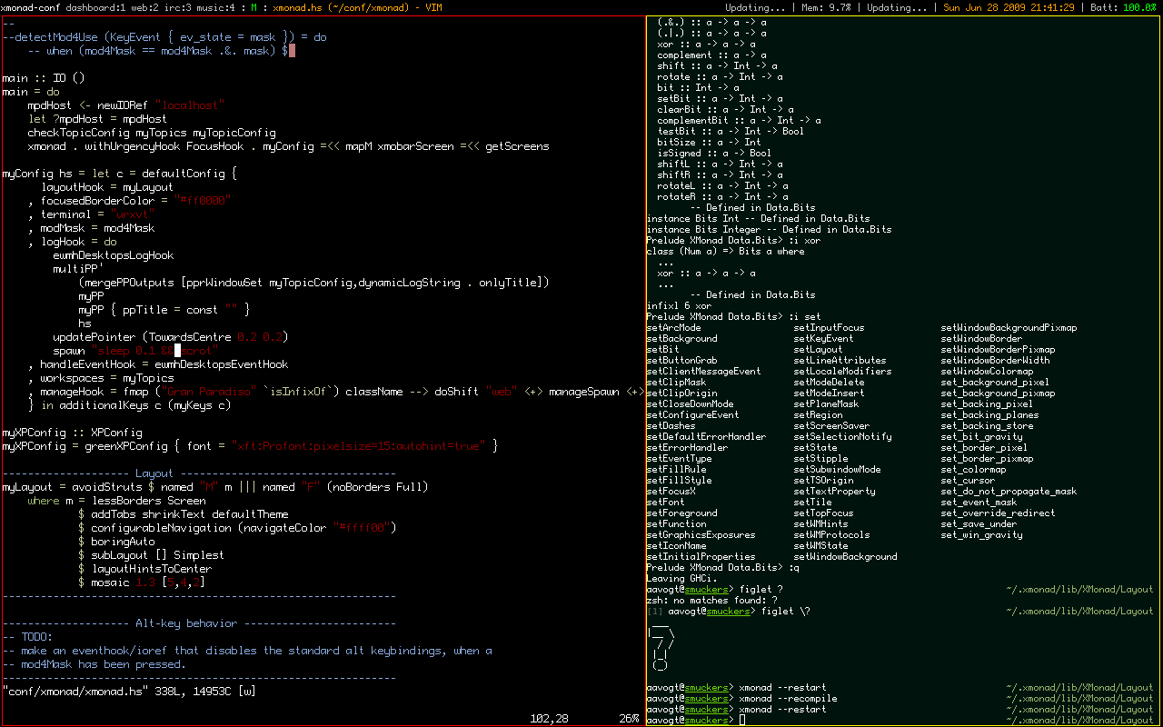

Slide 17

Stable VS Rolling Release
A Software Release Life Cycle is the sequence of various stages through which a software's development evolves from a pre-alpha phase into a production phase. It is a continuous process because any software will always have its updated version until and unless it reaches end of life.

Slide 18

Stable Release
The Stable release (also known as fixed, static or versioned release) distributions are the ones that hold back the updates and new software packages for a fixed period until a new version of an OS is relesed.
Great for new users
The software is always several versions behind
Eventually has to be re-installed

Slide 19

Rolling Release
The Rolling release distributions do not have a single version. Instead the packages may be updated as soon as a new version of a package comes out.
Bleeding edge software
Frequent updates (weekly)
Conflicting packages

Slide 20

My Linux
Distribution: Arch Linux
"[…] a lightweight and flexible Linux® distribution that tries to Keep It Simple"
Advanced and minimal
Rolling release
Well documented (ArchWiki)
Big community (YouTube videos, blog posts, forums, etc.)
Pacman is a feature-rich package manager (parallel downloads)
One of the largest community-driven repository (AUR) with 81k+ packages

Slide 21
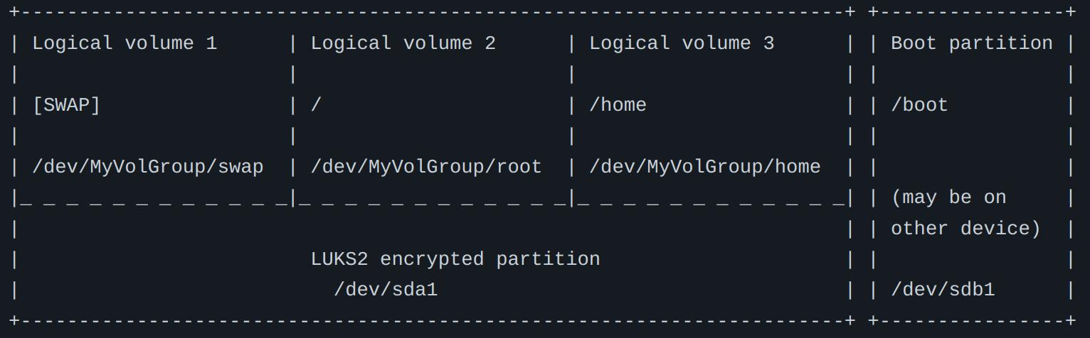
Security
Vanilla Linux kernel
LVM on LUKS full system encryption
Normal and Root users

Slide 22
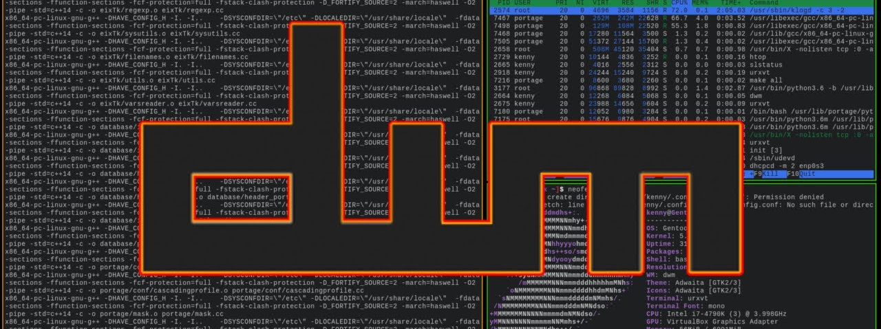
Graphical Environment
Display server: Xorg
Compositor: Picom
Window manager: DWM Flexipatch

Slide 23
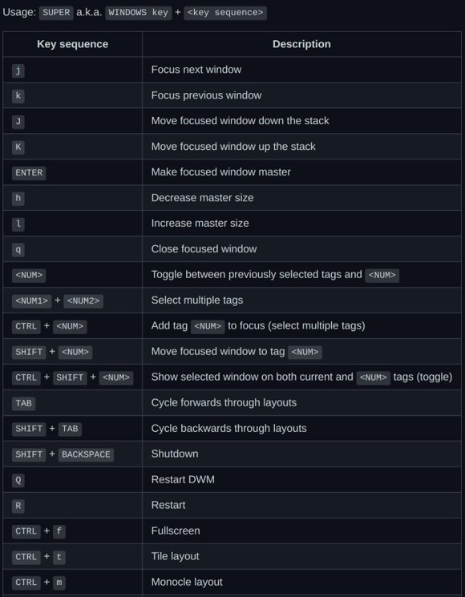
Hotkeys

Slide 24


Slide 25

Demonstration
DWM window operations
DWM 6 window layouts

Slide 26

Command Line
Terminal: Alacritty
Shell: ZSH
Text editor: Neovim

Slide 27
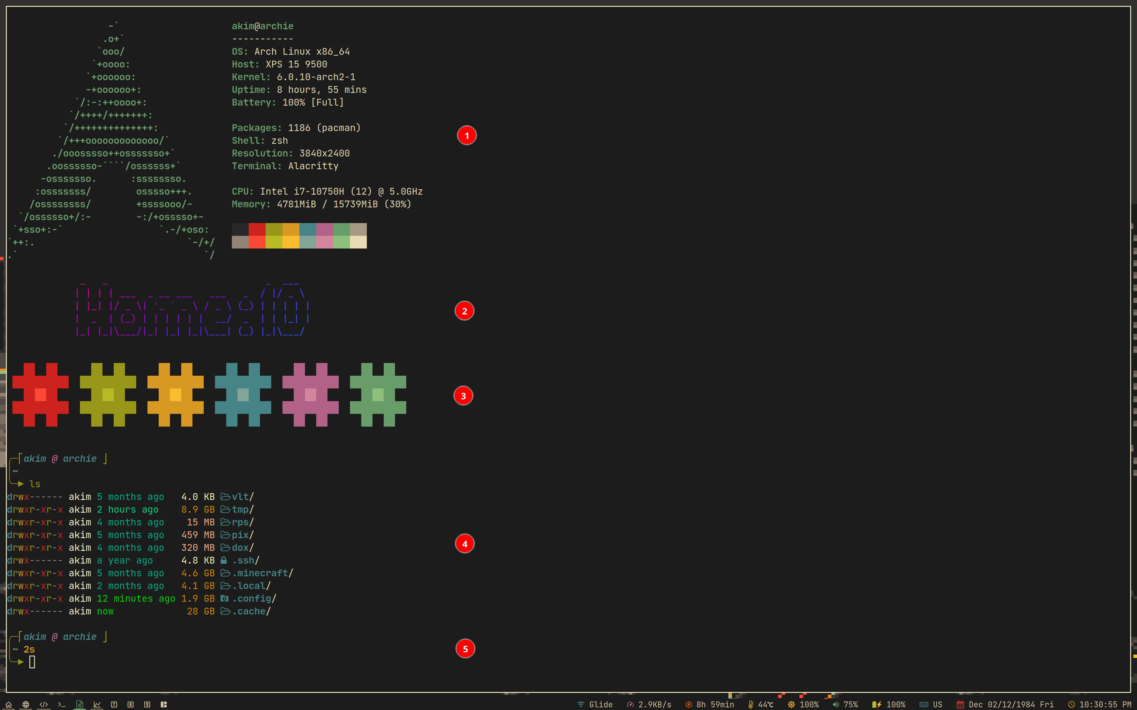

Slide 28
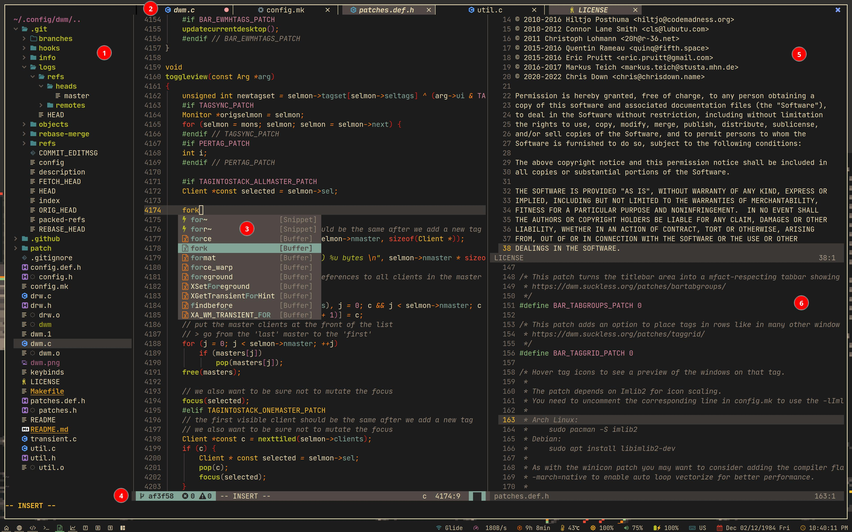

Slide 29

Backup System
Partial Backup: Borg
$ borg create --stats --progress \
--compression=zstd,22 $MY_MNT/bups::1 ~
Full Backup: dd
# dd if=/dev/sda of=/dev/sdb bs=64K \ conv=noerror,sync status=progress

Slide 30

Future Improvements
Notification system
Clickable status bar modules
Debugging for Neovim
Optimise performance
More DWM patches

